Slide 1
Chapter 2.4
Probability of an Event
Probability of an Event
The likelihood of the occurrence of an event resulting from such a statistical experiment is evaluated by means of a set of real numbers called weights or probabilities ranging from 0 to 1.
The probability of an event A is the sum of the weights of all sample points in A. Therefore,
Furthermore, if A₁, A₂, A₃, ... is a sequence of mutually exclusive events, then
If an experiment can result in any one of N different equally likely outcomes, and if exactly n of these outcomes correspond to event A, then the probability of event A is

Slide 2
Chapter 2.4
Probability of an Event
Probability of an Event
A coin is tossed twice. What is the probability that at least one head occurs?
Sample space of the experiment, 4 events
Events of interest, at least one head occurs

Slide 3
Chapter 2.4
Probability of an Event
Probability of an Event
A dice is loaded in such a way that an even number is twice as likely to occur as an odd number. If E is the event that a number less than 4 occurs on a single toss of the dice, find P(E).
As the last example, let A be the event that an even number turns up and let B be the event that a number divisible by 3 occurs. Find P(A ∪ B) and P(A ∩ B).

Slide 4
Chapter 2.5
Additive Rules
Additive Rules
If A and B are any two events, then
S
A
A ∩ B
B
A ∪ B
S
If A and B are mutually exclusive, then
A
B
A ∪ B
For three events A, B, and C,
?
Can you prove using Venn diagram?

Slide 5
Chapter 2.5
Additive Rules
Additive Rules
The probability of John to be hired by company A is 0.8, and the probability that he gets an offer from company B is 0.6. If, on the other hand he believes that the probability that he will get offers from both companies is 0.5, what is the probability that he will get at least one offer from these two companies?
What is the probability of getting a total of 7 or 11 when a pair of fair dice are tossed?
Let A be the event that 7 occurs and B the event that 11 comes up. The events A and B are mutually exclusive, since a total of 7 and 11 cannot both occur on the same toss. Therefore,

Slide 6
Chapter 2.5
Additive Rules
Additive Rules
If A and A’ are complementary events, means A ∩ A’ = ∅ and A ∪ A’ = S, then
The probabilities that an automobile mechanic will service 3, 4, 5, 6, 7, or 8 or more cars on any given workday are, respectively, 0.12, 0.19, 0.28, 0.24, 0.10, and 0.07. What is the probability that he will service at least 5 cars on his next day at work?
Let E be the event that at least 5 cars are serviced, then E’ is the event that fewer than 5 cars are serviced.

Slide 7
Chapter 2.6
Conditional Probability
Conditional Probability
The probability of an event B occurring when it is known that some event A has occurred is called a conditional probability.
It is denoted by symbol P(B|A), usually read “the probability that B occurs given that A occurs” or simply “the probability of B, given A.”
The probability P(B|A) can be seen as an “updating” of P(B) based on the knowledge that even A has occurred.
The conditional probability of B, given A, denoted by P(B|A), is defined by

Slide 8
Chapter 2.6
Conditional Probability
Conditional Probability
If a fair dice is tossed once, what is the probability of getting a 6, given that the number you got is an even number?

Slide 9
Chapter 2.6
Conditional Probability
Conditional Probability
The probability that a regularly scheduled flight departs on time is P(D) = 0.83; the probability that it arrives on time is P(A) = 0.82; and the probability that it departs and arrives on time is P(D ∩ A) = 0.78. Find the probability that a plane
arrives on time given that it departed on time,
departed on time given that it has arrived on time, and
arrives on time given that it did not depart on time
D
S
A
A ∩ D
A ∩ D’
D’

Slide 10
Chapter 2.6
Conditional Probability
Conditional Probability
A dice is loaded in such a way that an even number is twice as likely to occur as an odd number. It is tossed once.
What is the probability that event B of getting a perfect square will turn out?
What is the probability that even B will happen when it is known that the toss of the dice resulted in a number greater than 3?

Slide 11
Chapter 2.6
Conditional Probability
Independent Events
Two events A and B are independent if and only if
Otherwise, A and B are dependent.

Slide 12
Chapter 2.7
Multiplicative Rules
Multiplicative Rules
If in an experiment the events A and B can both occur, then
Since A ∩ B and B ∩ A are equivalent, it follows that
Two events A and B are independent if and only if
Suppose that we have a fuse box containing 20 fuses, of which 5 are defective. If 2 fuses are selected at random and removed from the box in succession without replacement, what is the probability that both fuses are defective?
Let A be the event that the first fuse is defective and B the event that the second fuse is defective, then

Slide 13
Chapter 2.7
Multiplicative Rules
Multiplicative Rules
One bag contains 4 white balls and 3 black balls, and a second bag contains 3 white balls and 5 black balls. One ball is drawn from the first bag and placed unseen in the second bag. What is the probability that a ball now drawn from the second bag is black?
B₁ : the drawing of a black ball from bag 1
B₂ : the drawing of a black ball from bag 2
W₁ : the drawing of a white ball from bag 1

Slide 14
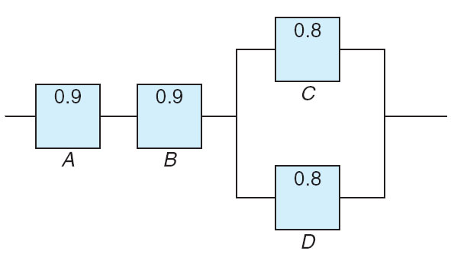
Chapter 2.7
Multiplicative Rules
Multiplicative Rules
An electrical system consists of four components as illustrated below. The system works if components A and B work and either of the components C or D work. The reliability (probability of working) of each component is also indicated. Find the probability that
the entire system works
the component C does not work, given that the entire system works
the entire system works given that the component C does not work.
Assume that four components work independently.

Slide 15
Chapter 2.7
Multiplicative Rules
Multiplicative Rules
Find the probability that the component C does not work, given that the entire system works
Find the probability that the entire system works given that the component C does not work

Slide 16
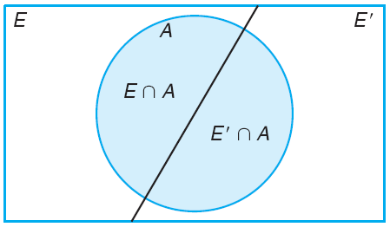
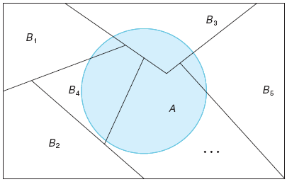
Chapter 2.8
Bayes’ Rule
Bayes’ Rule
Refer to the following figure.
If the events B₁, B₂, ..., B_{k} constitute a partition of the sample space S such that P(B_{i}) = 0 for i = 1, 2, ..., k, then for any event A of S,

Slide 17
Chapter 2.8
Bayes’ Rule
Bayes’ Rule
A travel agent offers 4-day and 8-day trips around USA. Based on long-range sales, the probability that a customer will book a 4-day trip is 0.75. Of those that book that trip, 60% also order the bus pass. But only 30% of 8-day trip customers order the bus pass. A randomly selected buyer purchases a bus pass and a round trip. What is the probability that the trip she orders is a 4-day trip?
F : the customer books a 4-day round trip
E : the customer books an 8-day round trip
B : the customer orders a bus pass

Slide 18
Chapter 2.8
Bayes’ Rule
Bayes’ Rule
In a certain assembly plant, three machines, B₁, B₂, and B₃, make 30%, 45%, and 25%, respectively, of the products. It is known from past experience that 2%, 3%, and 2% of the products made by each machine, respectively, are defective. Now, suppose that a finished product is randomly selected. What is the probability that it is defective?
B₁ : the product is made by machine B₁
B₂ : the product is made by machine B₂
B₃ : the product is made by machine B₃
D : the product is defective

Slide 19
Chapter 2.8
Bayes’ Rule
Bayes’ Rule
With reference to the last example, if a product were chosen randomly and found to be defective, what is the probability that it was made by machine B₃?

Slide 20
Probability and Statistics
Homework 2A
A satellite can fail for many possible reason, two of which are computer failure and engine failure. For a given mission, it is known that: The probability of engine failure is 0.008. The probability of computer failure is 0.001. Given engine failure, the probability of satellite failure is 0.98. Given computer failure, the probability of satellite failure is 0.45. Given any other component failure, the probability of satellite failure is zero.
Determine the probability that a satellite fails. (Soo.2.11)
Determine the probability that a satellite fails and is due to engine failure.
Assume that engines in different satellites perform independently. Given a satellite has failed as a result of engine failure, what is the probability that the same will happen to another satellite?
You have two boxes, one with 4 black balls and 3 white balls, the other with 2 black balls and 2 white balls. You pick one box at random and then select a ball from the box. (Utah.L3)
What is the probability that the ball is white?
If you picked a black ball, what is the probability that it comes from the first box?

